Slide 1


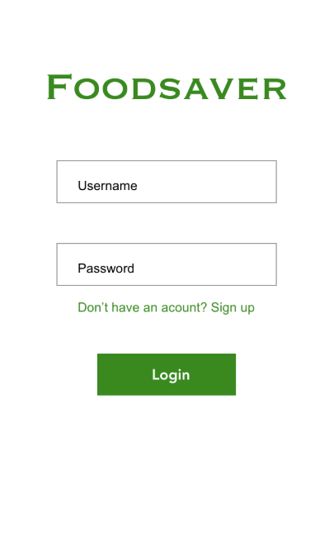
PEHMO-software company
Päivi Meros
Eashin Matubber
Mikko Vallaskivi
Huong Pham
Our Excellent Group!
FOODSAVER
Notes:
Introducing group:
PÄIVI: I have Masters Degree in Computing, Information Systems and Computer Science, Laurea University of Applied Sciences. In my dissertation, I published research paper "Success Factors of Information Sharing in the Field of New Media Art" at the international conference in Portugal, KMIS (Knowledge Management and Information Sharing).
I have worked as a Marketing Communications Director in Seclion Oy, a Finnish consulting and software development company. I’ve been responsible of managing Seclion Oy and Spotilla® SaaS brand development and executing the marketing campaings for various customer segments with excellent results.

Slide 2
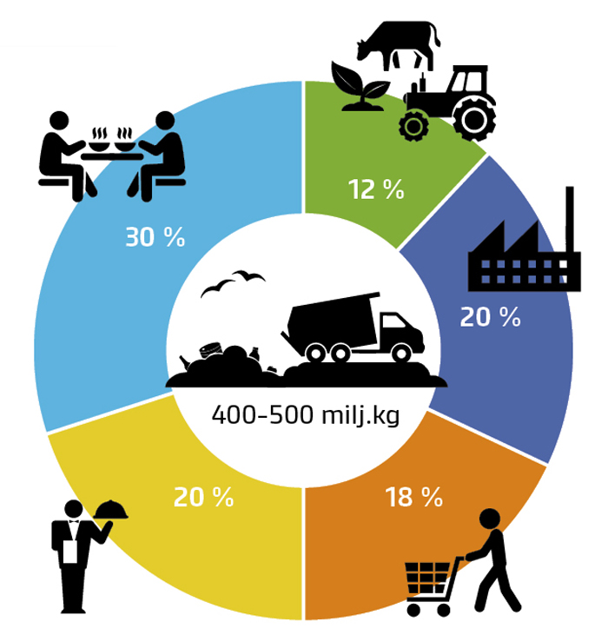
Why?
Biggest food waste sector is household sector *
Single households and women are wasting most food => Our marketing target *
The total climate impact of food waste was approximately 1000 million kilograms of CO₂-equivalent per year. **
"Did you know that the environmental load of a hammered end of the debris is greater than that of the packaging.
Sources:
* Luke, Natural Resouces Insitute Finland (Foodspill)
** MTT Agrifood Research Finland, Responsible Food Chain – Better Consumer Well-being
Notes:
Slogans:
"Did you know that the environmental load of a hammered end of the debris is greater than that of the packaging.
"Around 130 million kilograms of food waste is generated each year (23 kg per capita/year) from the household sector.
Annually discarded food from Finnish households is approximately equal to the annual carbon dioxide emissions of 100,000 cars.
At the national level Finnish households discard food of value €400–550 million annually.
Altogether, households, restaurants, food industry and retails produce 335–460 million kilograms of food waste in Finland per year.
The total climate impact of food waste was approximately 1000 million kilograms of CO2-equivalent per year.

Slide 3


FOODSAVER
Your own food list
Generate food recipies
Share foods with community
Shops for missing ingredients
Take a look at your FOODSAVER-API. There may be ingredients for a full dinner, and so there is no need to go shopping
Notes:
COMPETITOR COMBANIES
http://froodly.com/
Grosery store discounts
http://saasyoda.fi
Generate recipies by ingrients
BUT Pehmo- will offer it all in one place!

Slide 4
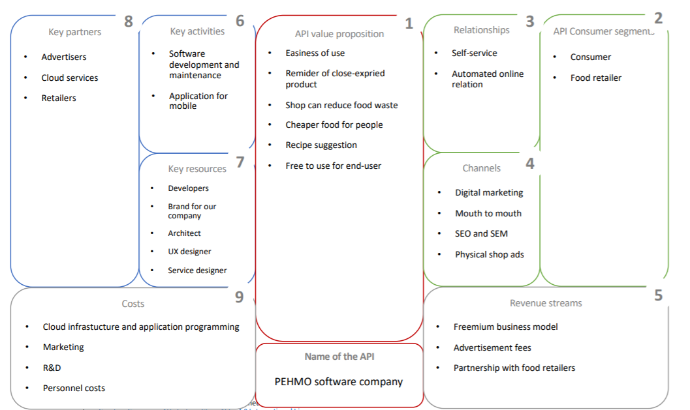

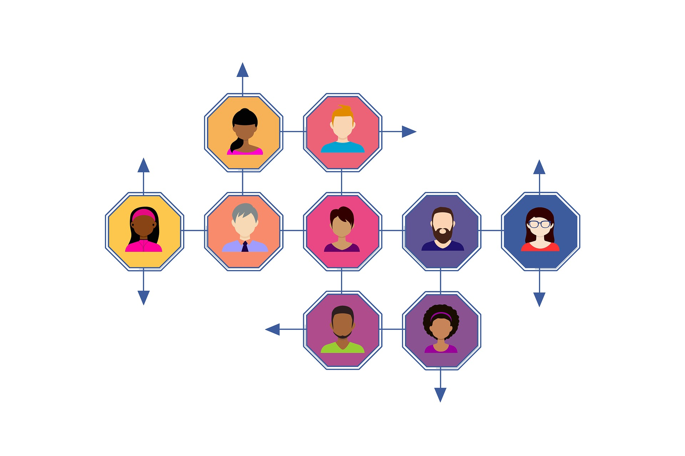
How?
Freemium
We need for our resource
Developer Evangelist plus as Brand Manager and Developer site.
Developers
Architect
UX- Designer
Service Designer
Customer support
Revenue
Comes out off
co-operated shop adds
or straight sponsor.

Slide 5

Marketing Plan – Digital Marketing
We market you API to the right audience.
SEO and SEM
Reach of the app co-operation with shops
Also physical adds go in co-operation with shops
Notes:
Marketing example: adds, infograf,

Slide 6
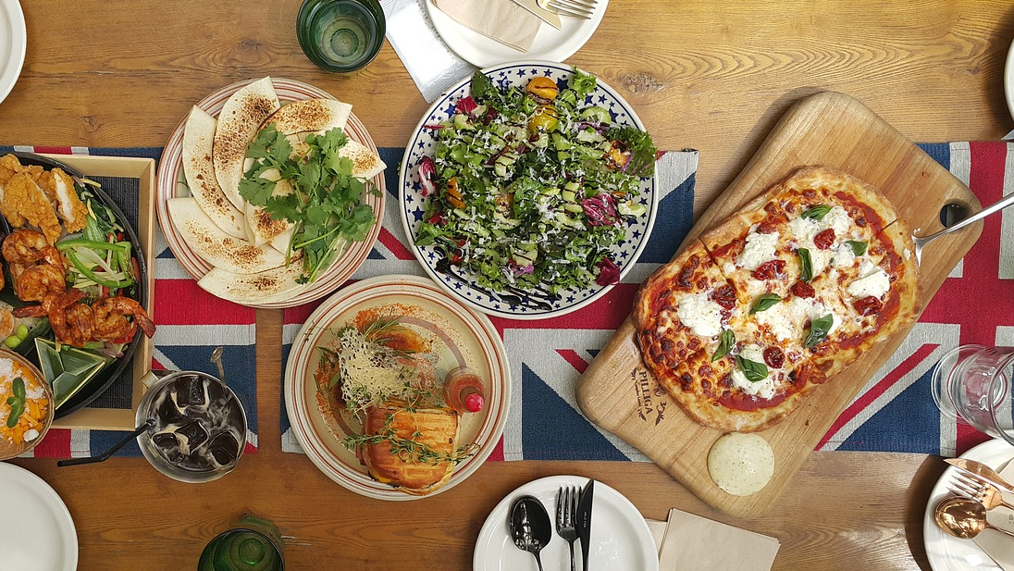
Thank you! Enjoy your food and save the planet from food waste
By PEHMOs FoodSaver

Slide 7
OPTIONAL EXTRA SLIDES IF NEEDED…

Slide 8
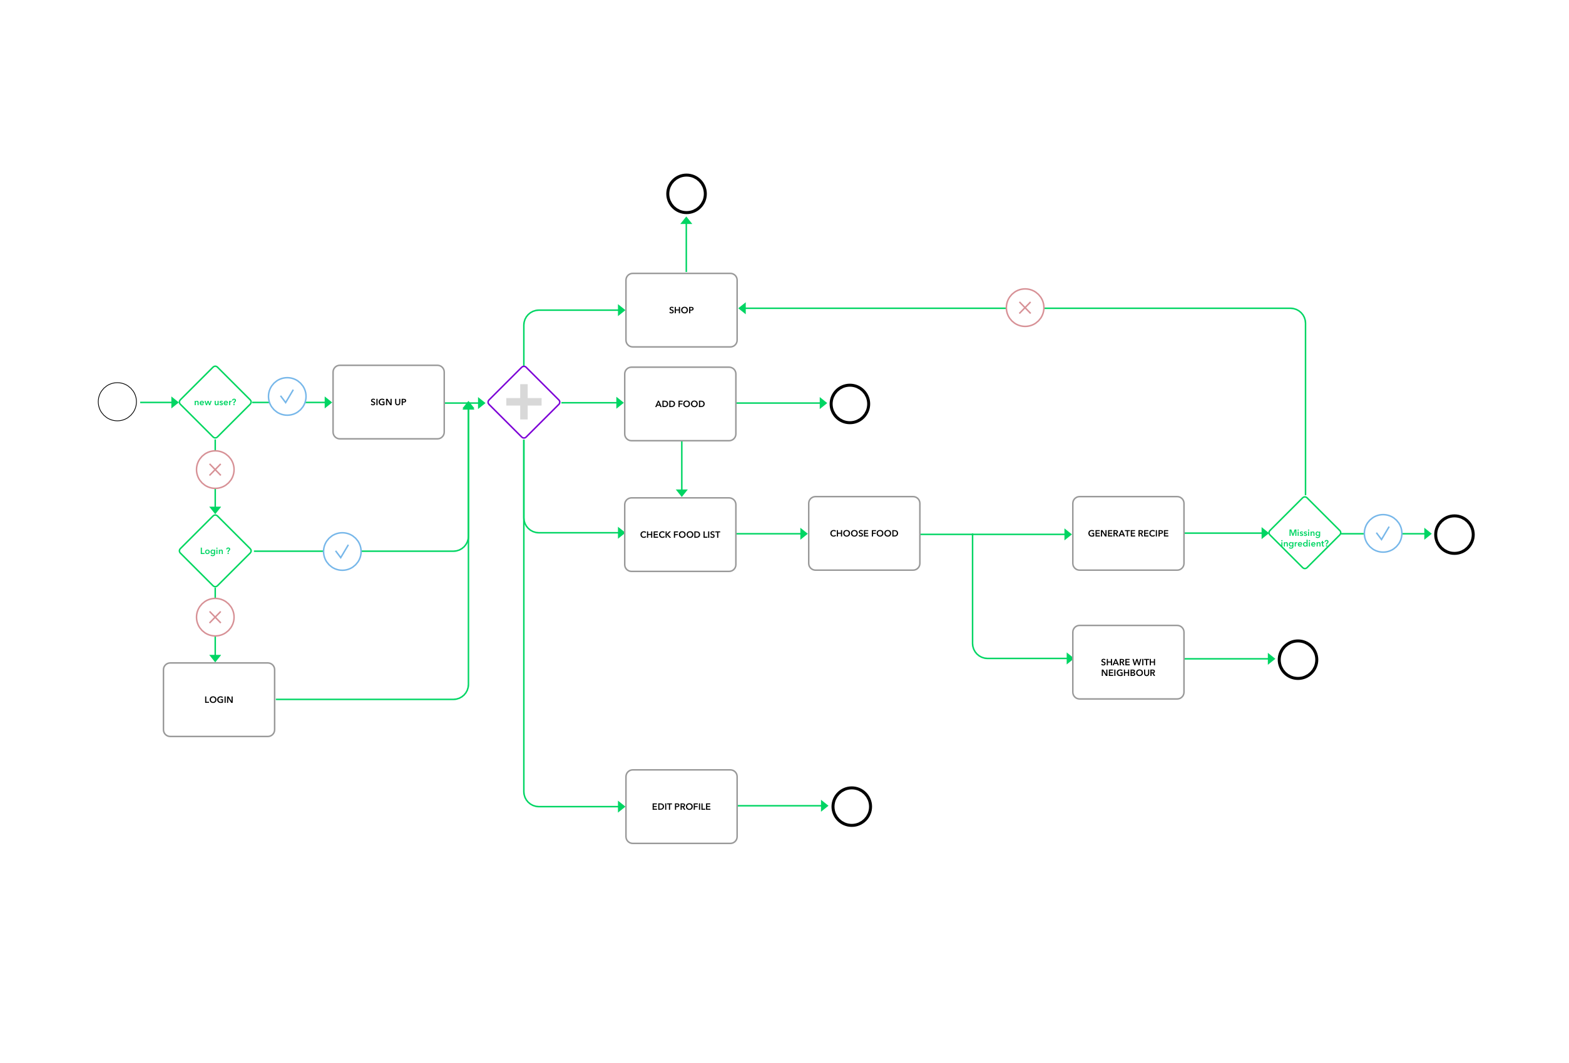
Infograf

